Slide 2
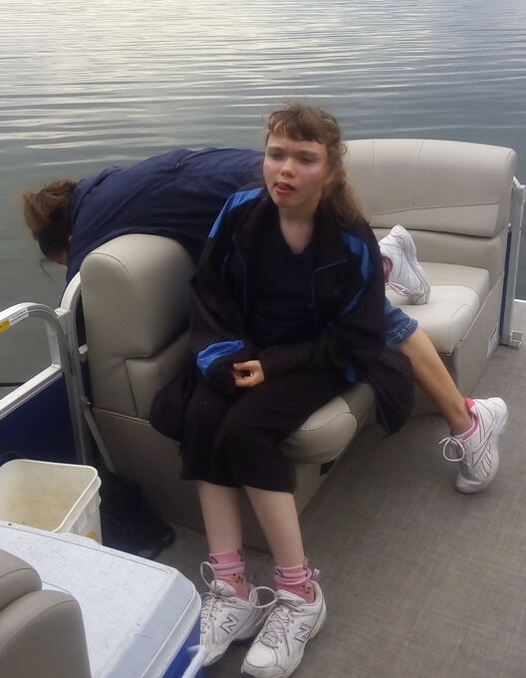
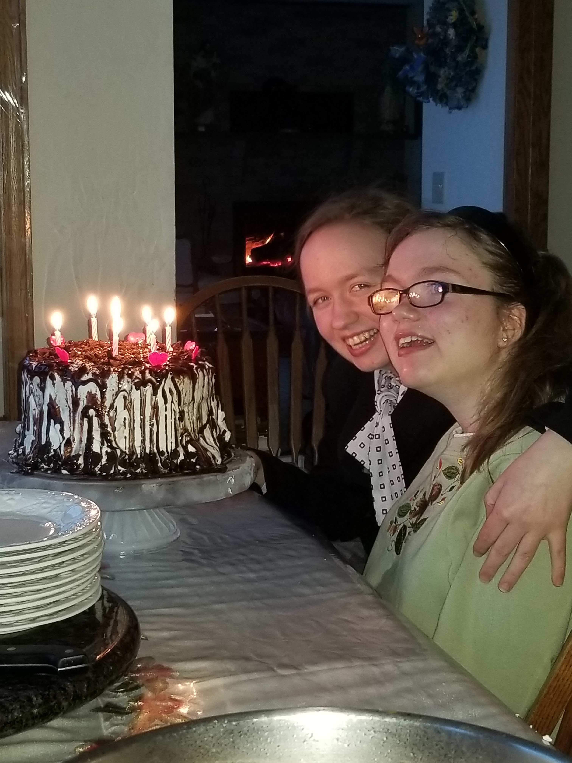
Catherine’s Story
Born 6 weeks premature
7 isolated cases of seizures
Suppose to be in the bottom 10% of head, hand and feet size
Went to John Hopkins to be part of a National Rett Study
Found out that we truly have a Shaklee miracle with Catherine.
************
On no medications
No seizures in the past 10 years.
In the normal growth range in size
As a girl with Rett Syndrome, she is suppose to be in a wheel chair- she walks!
Her incredible physical ability, thanks to Shaklee, is Priceless!

Slide 44
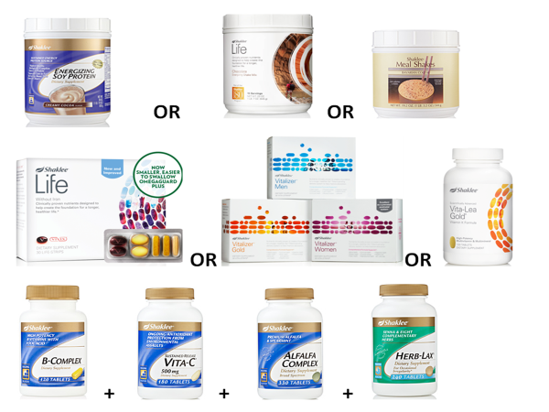

Slide 47
No end in sight…no solution in sight?
2013
68% of American have been defined as overweight.*
15% – <25%
25% – <30%
30% – <35%
≤35%
Source: Behavioral Risk Factor Surveillance System, CDC. *Centers for Disease Control and Prevention

Slide 48
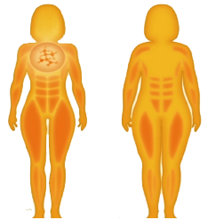
Shaklee 180™ Program is Design to…
KEEP MUSCLE
PROTECT METABOLISM
(Muscle = Metabolism)
Enhanced fat loss → quality weight and inch loss
Shaklee 180 with Leucine
Designed to help you lose fat
Typical Diets
Lose Fat and Muscle

Slide 71
STARTER KIT
You would need to spend over $3,400 to get the same cleaning power from major name brands!*
60 Bottles of Fantastik®, 32 oz.
32 Bottles of Mop ‘n Glo®, 32 oz.
728 Bottles of Windex®, 26 oz.
1 Bottle of Woolite®, 50 oz.
1 Container of Clorox® Wipes
1 Bottle of Soft Scrub®
2.5 Boxes of Cascade®, 45 oz.
2 Boxes of Tide®, 50 oz.
3 Bottles of Downy®, 20 oz.
1 Box of Bounce®
*Based on number of uses per label directions.
®
®

Slide 82
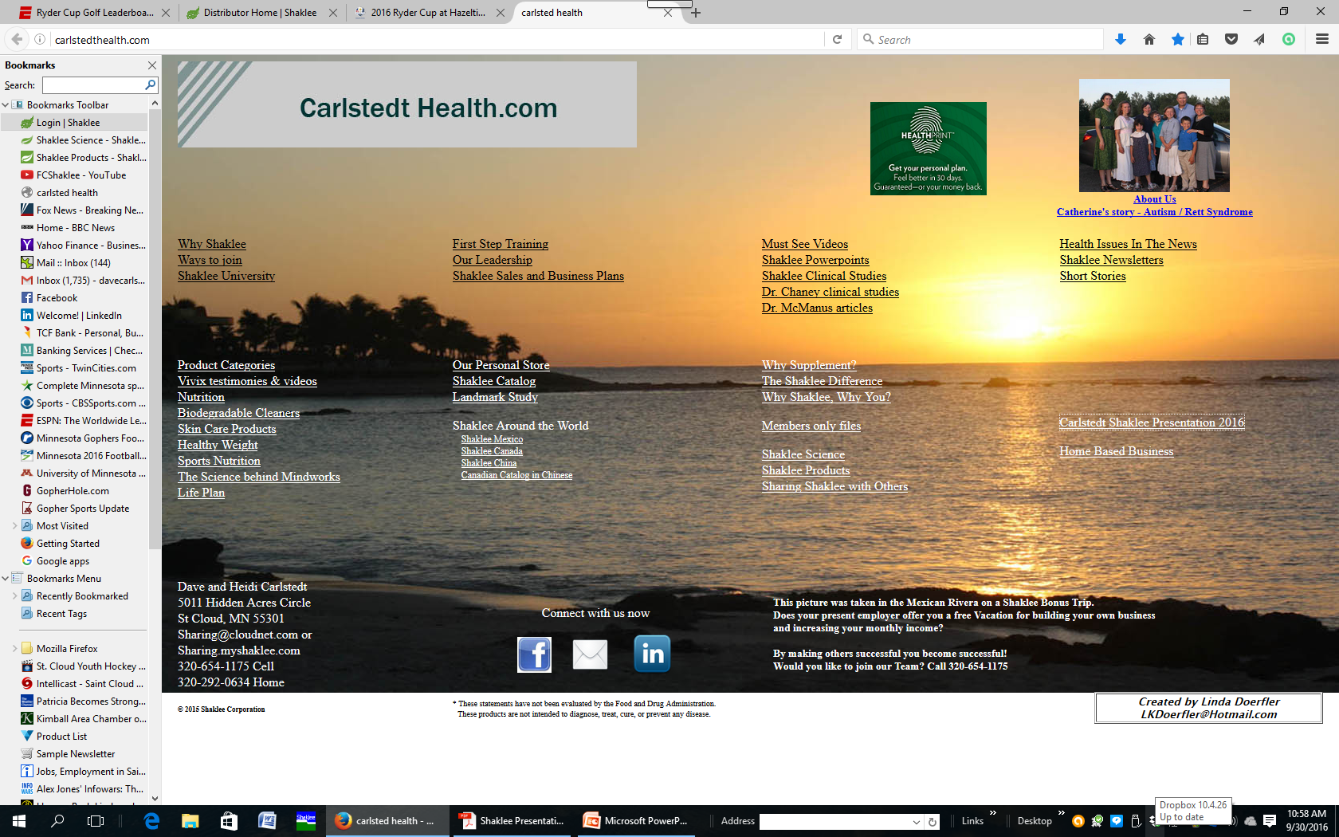

Slide 86
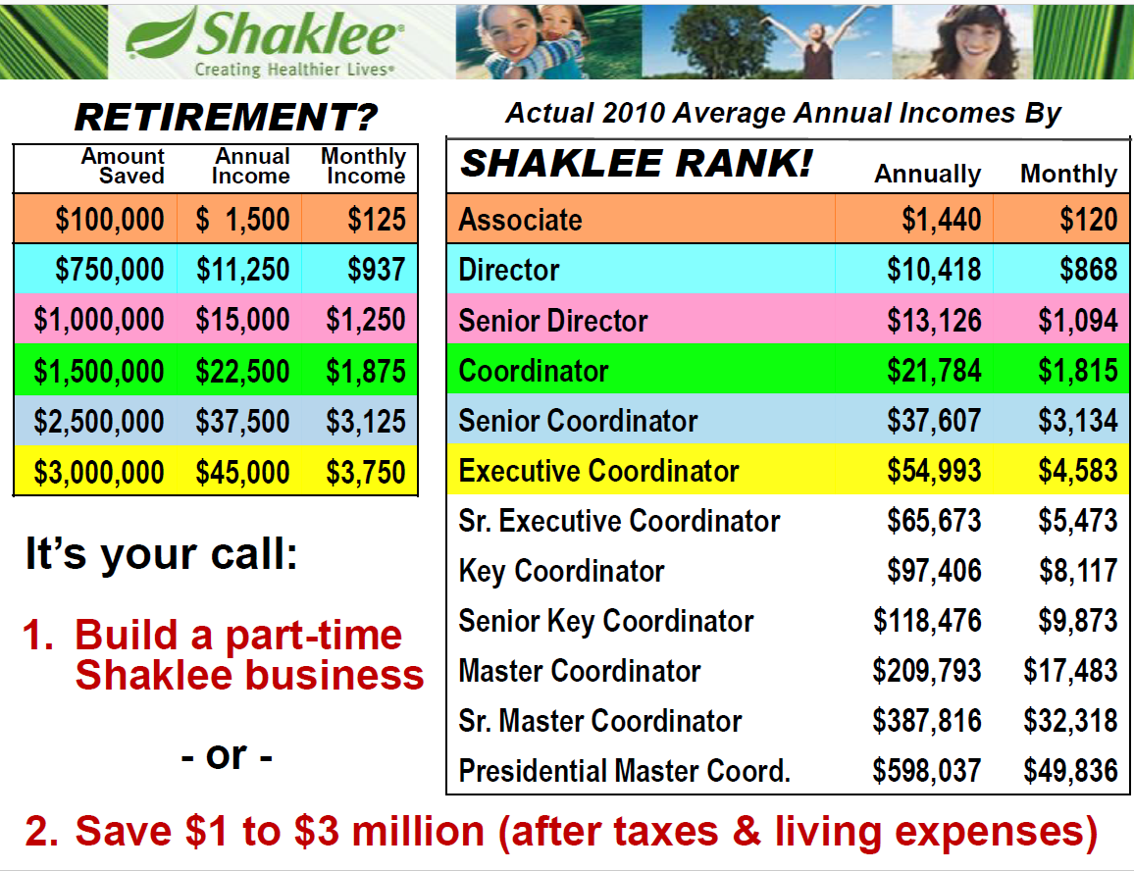

Slide 88
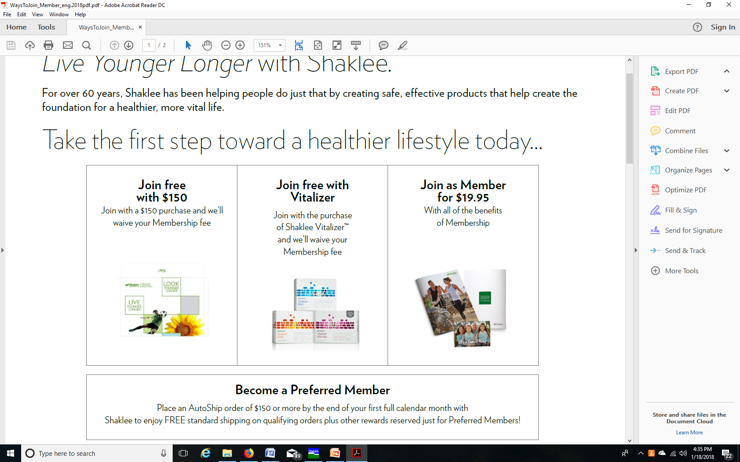

Slide 89
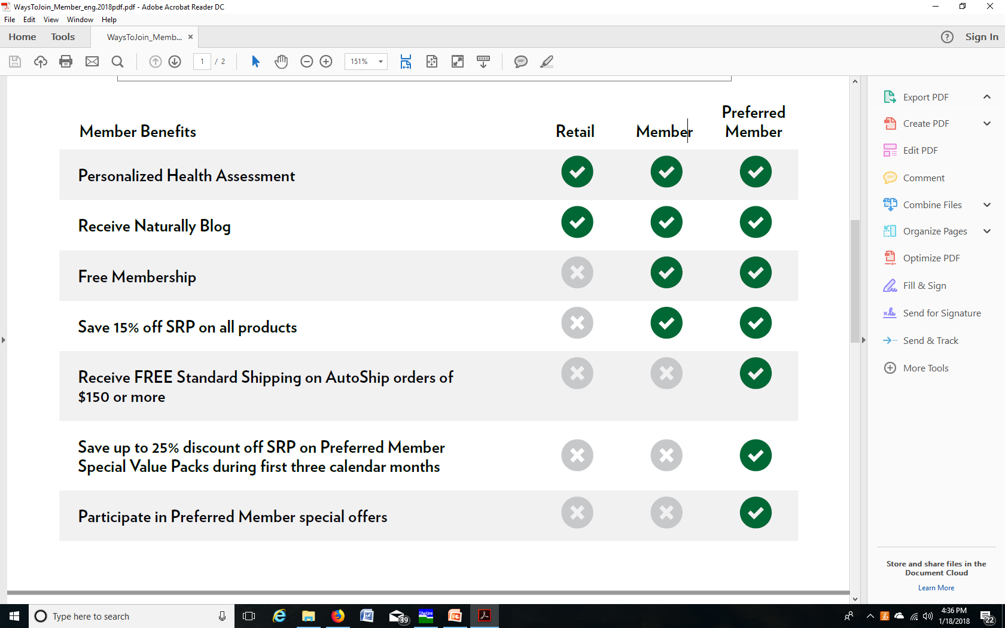

Slide 91
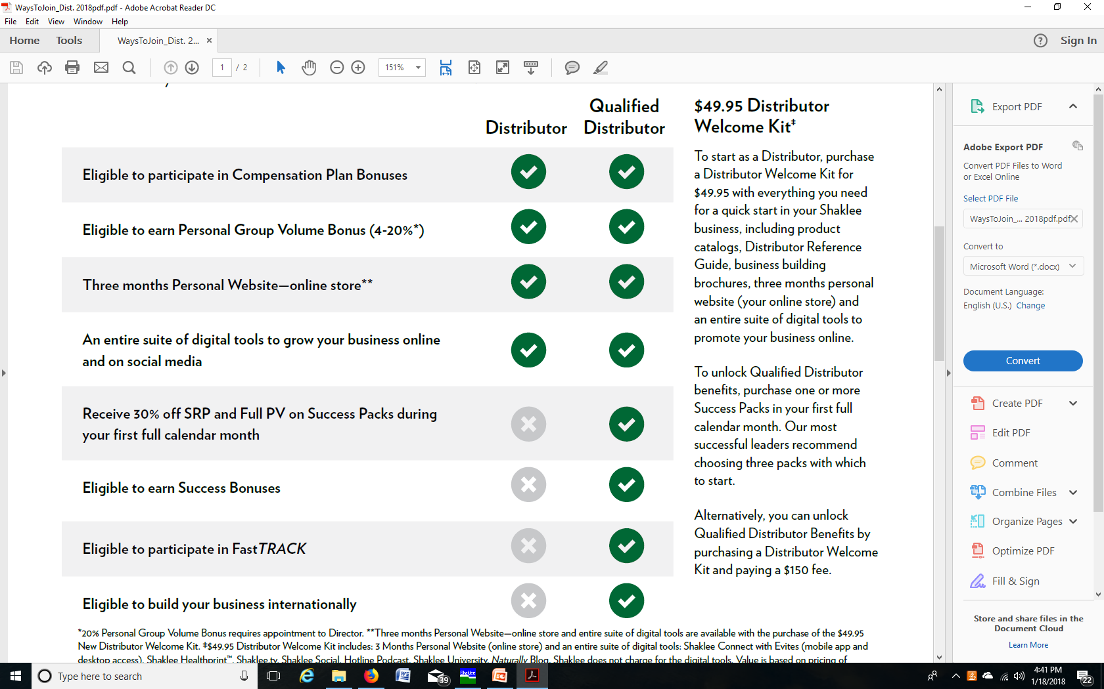

Slide 95
2017 DREAM TRIP Playa del Carmen April 2–7, 2017

Slide 96
Top Achievers Trip 2017 - Machu Picchu
Qualification Period: January 1, 2016 – December 31, 2016
Trip Dates: May 18–23, 2017
850 points earns you a trip for 2 to Machu Picchu

